Slide 1
FINAL YEAR PROJECT VIVA PRESENTATION
SMS Spam Detection via Deep Learning
Parallel Code and Theory Architectural Walkthrough & Empirical Evaluation
Presenter: Abhishek , Akshay Pratap Singh , Shashwat Shukla (72 , 64 , 116) | Supervisor: Mr. Raghav Sharma | Department of Computer Science

Slide 2
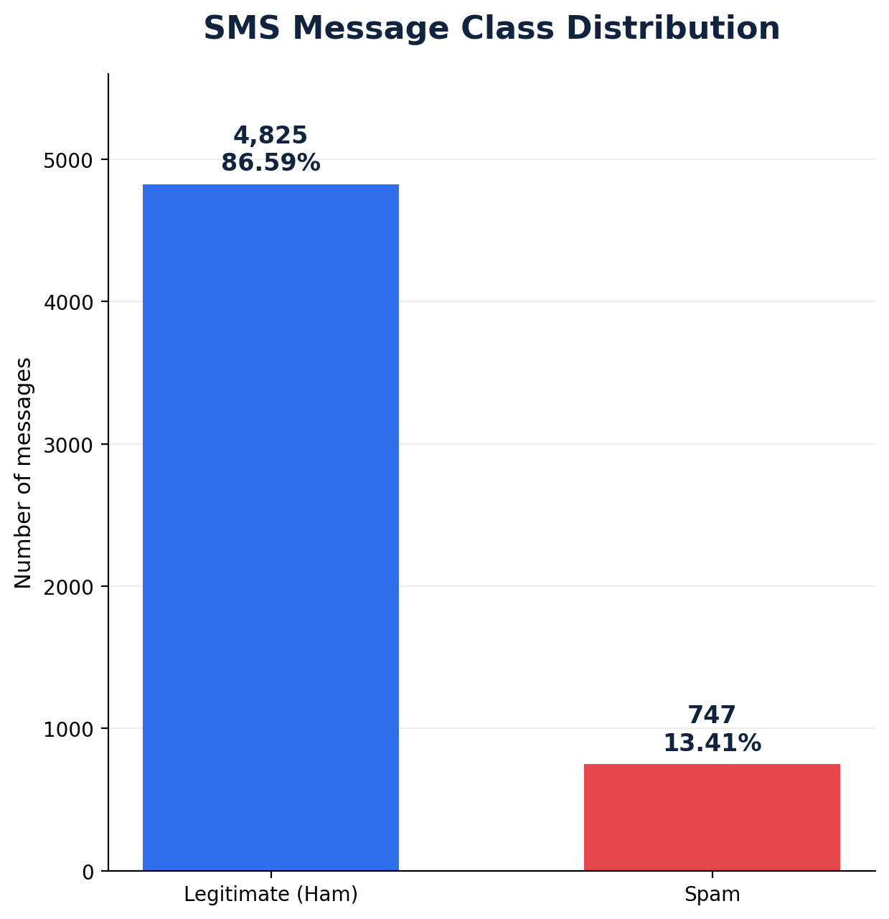
PROBLEM FORMULATION
Imbalanced Classes Require Precision-First Metrics
Operational Class Asymmetry
Class Imbalance: 86.59% legitimate ham versus 13.41% malicious spam in corpus.
False Positive Cost: Mislabelling legitimate OTPs or emergencies causes catastrophic loss.
False Negative Cost: Permits deceptive phishing and fraudulent lottery scams to reach inbox.
SMS Spam Detection | Parallel Code & Theory Walkthrough | Slide 2 of 13

Slide 3
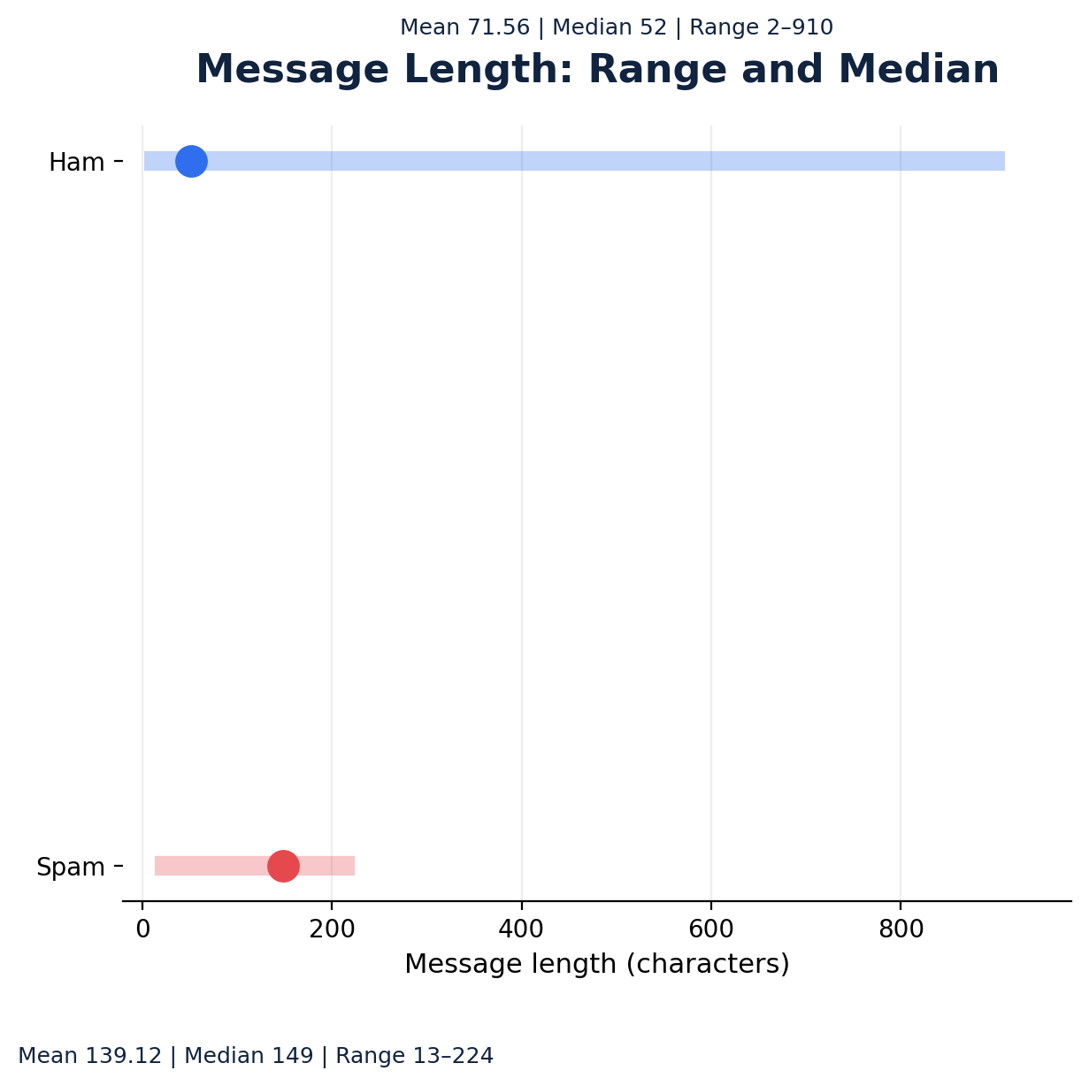
CORPUS CHARACTERISTICS
Spam Messages Exhibit Significantly Longer Token Lengths
Key Descriptive Findings
Ham Message Length: Mean 71.56 characters, median 52 characters (range 2–910 chars).
Spam Message Length: Mean 139.12 characters, median 149 characters (tight range 13–224).
Distribution Overlap: Length alone cannot separate classes reliably; sequence context is required.
SMS Spam Detection | Parallel Code & Theory Walkthrough | Slide 3 of 13

Slide 4
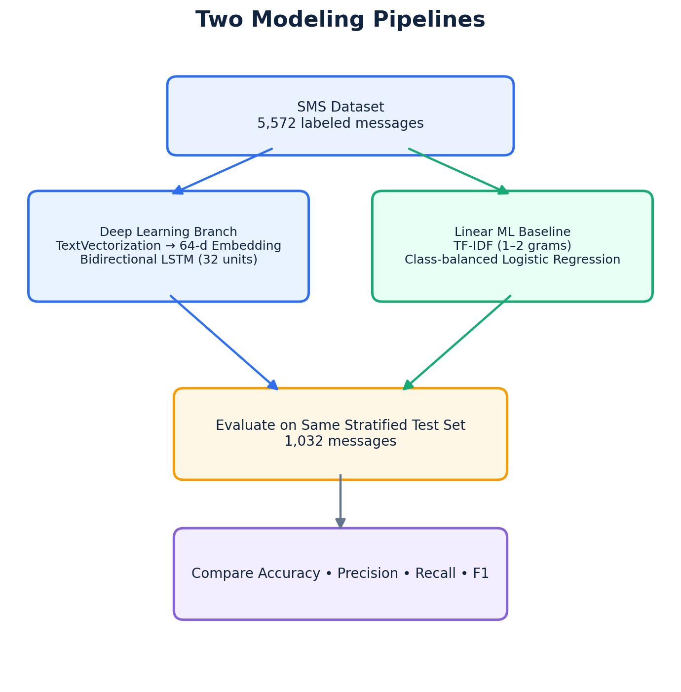
SYSTEM DESIGN
Dual Pipeline Architecture: Deep Learning vs Linear ML
Pipeline Stages
Data Processing: 5,572 rows loaded; labels validated; stratified 1,032 test holdout.
BiLSTM Branch: TextVectorization + 64-dim embedding + 32-unit bidirectional recurrent core.
Baseline Branch: Sublinear TF-IDF (1-2 ngrams) + balanced L2 Logistic Regression.
SMS Spam Detection | Parallel Code & Theory Walkthrough | Slide 4 of 13

Slide 5
STAGE 1: INGESTION & SPLITTING
Stratified Partitioning Eliminates Class Distribution Skew
Theoretical Principles
Corpus Integrity: Validation confirms 0 corrupt labels across 5,572 raw observations.
Stratified Sampling: Maintains exact 86.6% to 13.4% ratio across both train and test partitions.
Leakage Isolation: Strict split prevents test vocabulary from contaminating training states.
Python Implementation
df = pd.read_csv('data/SMSSpamCollection',
sep='\t', header=None,
names=['label', 'message'])
df['target'] = (df['label'] == 'spam').astype('int32')
X_train, X_test, y_train, y_test = train_test_split(
df['message'], df['target'],
test_size=0.185, random_state=42,
stratify=df['target']
)
SMS Spam Detection | Parallel Code & Theory Walkthrough | Slide 5 of 13

Slide 6
STAGE 2: TOKENIZATION & EMBEDDING
Integer Tokenization Maps SMS Strings to Dense Semantic Space
Theoretical Principles
Vocabulary Bounding: Max 10,000 tokens preserves key words while discarding rare noise.
Fixed Sequence Window: 100-token length accommodates 99.8% of SMS corpus without clipping.
Dense Word Embeddings: 64-dimensional vectors represent semantic proximity geometrically.
Python Implementation
MAX_TOKENS = 10_000
SEQUENCE_LENGTH = 100
vectorizer = layers.TextVectorization(
max_tokens=MAX_TOKENS,
output_mode='int',
output_sequence_length=SEQUENCE_LENGTH
)
vectorizer.adapt(X_train.to_numpy())
# Sequential Embedding Layer:
layers.Embedding(MAX_TOKENS, 64)
SMS Spam Detection | Parallel Code & Theory Walkthrough | Slide 6 of 13

Slide 7
STAGE 3: DEEP LEARNING ARCHITECTURE
Bidirectional Memory Recurrence Captures Dual-Direction Context
Theoretical Principles
Bidirectional Traversal: Forward and backward states resolve ambiguities from word order.
Gated Memory Units: Forget, input, and output gates eliminate vanishing gradient failures.
Dropout Regularization: 0.3 dropout prevents co-adaptation of recurrent hidden weights.
Python Implementation
model = tf.keras.Sequential([
layers.Input(shape=(), dtype=tf.string),
vectorizer,
layers.Embedding(MAX_TOKENS, 64),
layers.Bidirectional(layers.LSTM(32)),
layers.Dropout(0.3),
layers.Dense(32, activation='relu'),
layers.Dense(1, activation='sigmoid')
])
SMS Spam Detection | Parallel Code & Theory Walkthrough | Slide 7 of 13

Slide 8
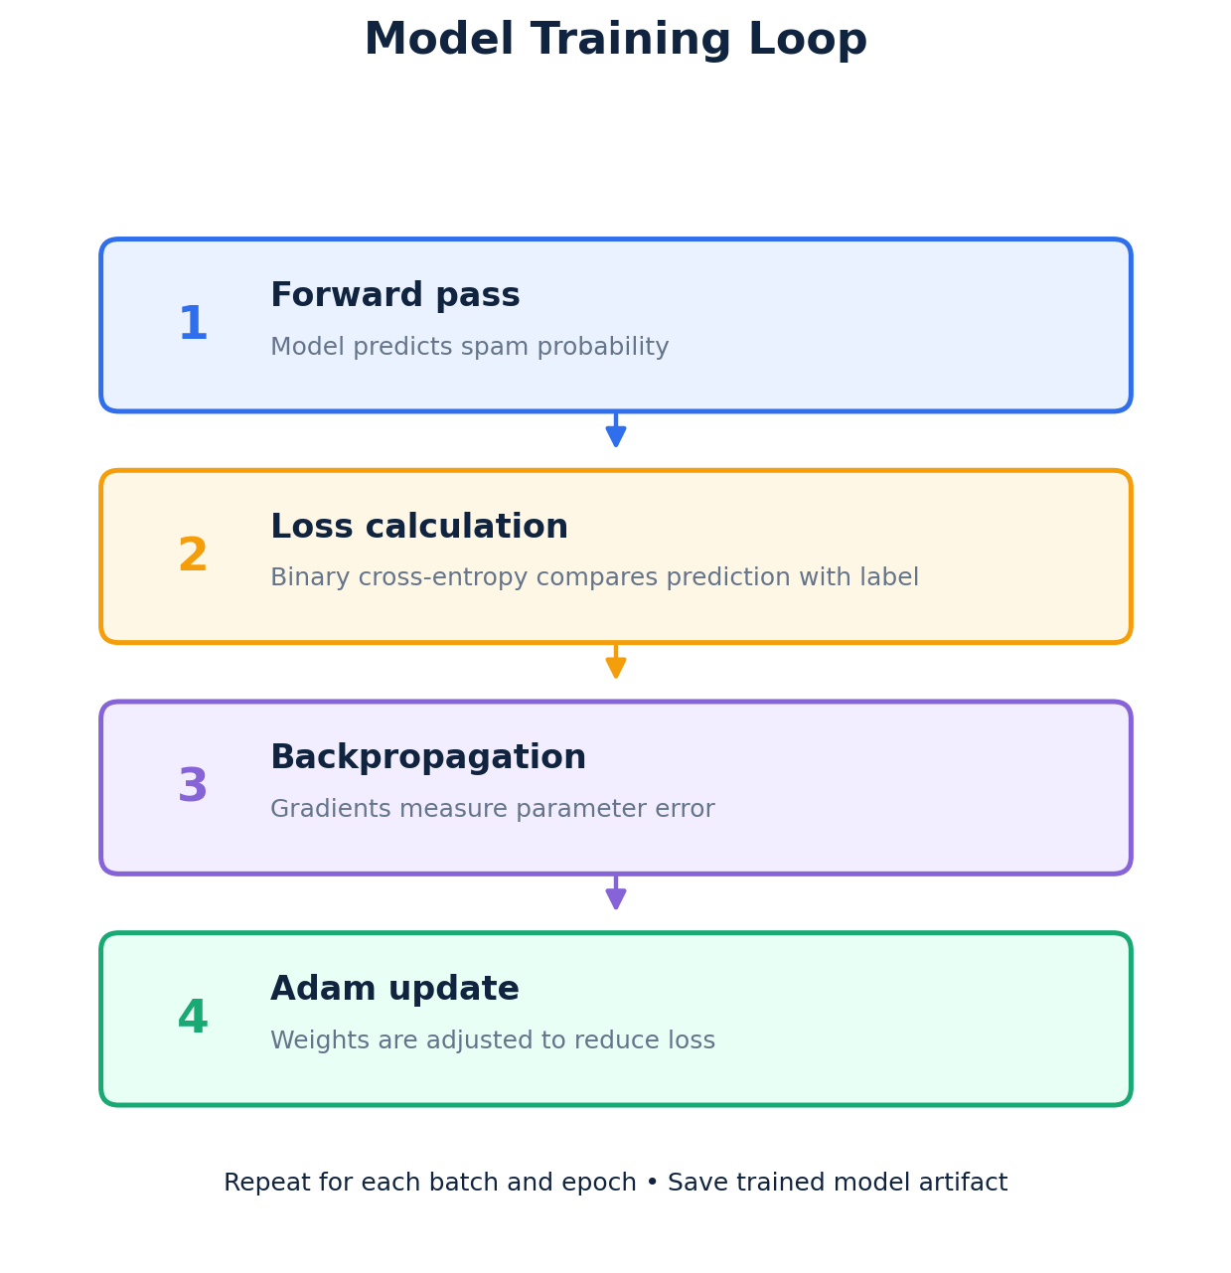
STAGE 4: OPTIMIZATION & FIT
Binary Cross-Entropy Loss Guides Adaptive Gradient Updates
Optimization & Code Walkthrough
Log-Loss Penalization: Binary cross-entropy severely penalizes confident incorrect tags.
Adam Optimizer: Adaptive moments prevent oscillations during recurrent backpropagation.
fit() Execution: model.fit(X_train, y_train, validation_split=0.1, epochs=10, batch_size=32).
Artifact Saving: model.save('models/sms_spam_bilstm.keras') stores graph and weights.
SMS Spam Detection | Parallel Code & Theory Walkthrough | Slide 8 of 13

Slide 9
STAGE 5: LINEAR BENCHMARK
Sublinear TF-IDF and Class Weighting Form a Strong Baseline
Theoretical Principles
N-Gram Collocations: Unigrams + bigrams capture key phrases like 'win cash' or 'claim now'.
Sublinear TF Scaling: Replaces raw frequency with 1 + log(tf) to dampen repetitive words.
Balanced Class Weighting: Inversely weights loss per class to counteract 86.6% ham dominance.
Python Implementation
baseline = Pipeline([
('tfidf', TfidfVectorizer(
lowercase=True, ngram_range=(1, 2),
max_features=20_000, sublinear_tf=True
)),
('classifier', LogisticRegression(
max_iter=2000, class_weight='balanced'
))
])
baseline.fit(X_train, y_train)
SMS Spam Detection | Parallel Code & Theory Walkthrough | Slide 9 of 13

Slide 10
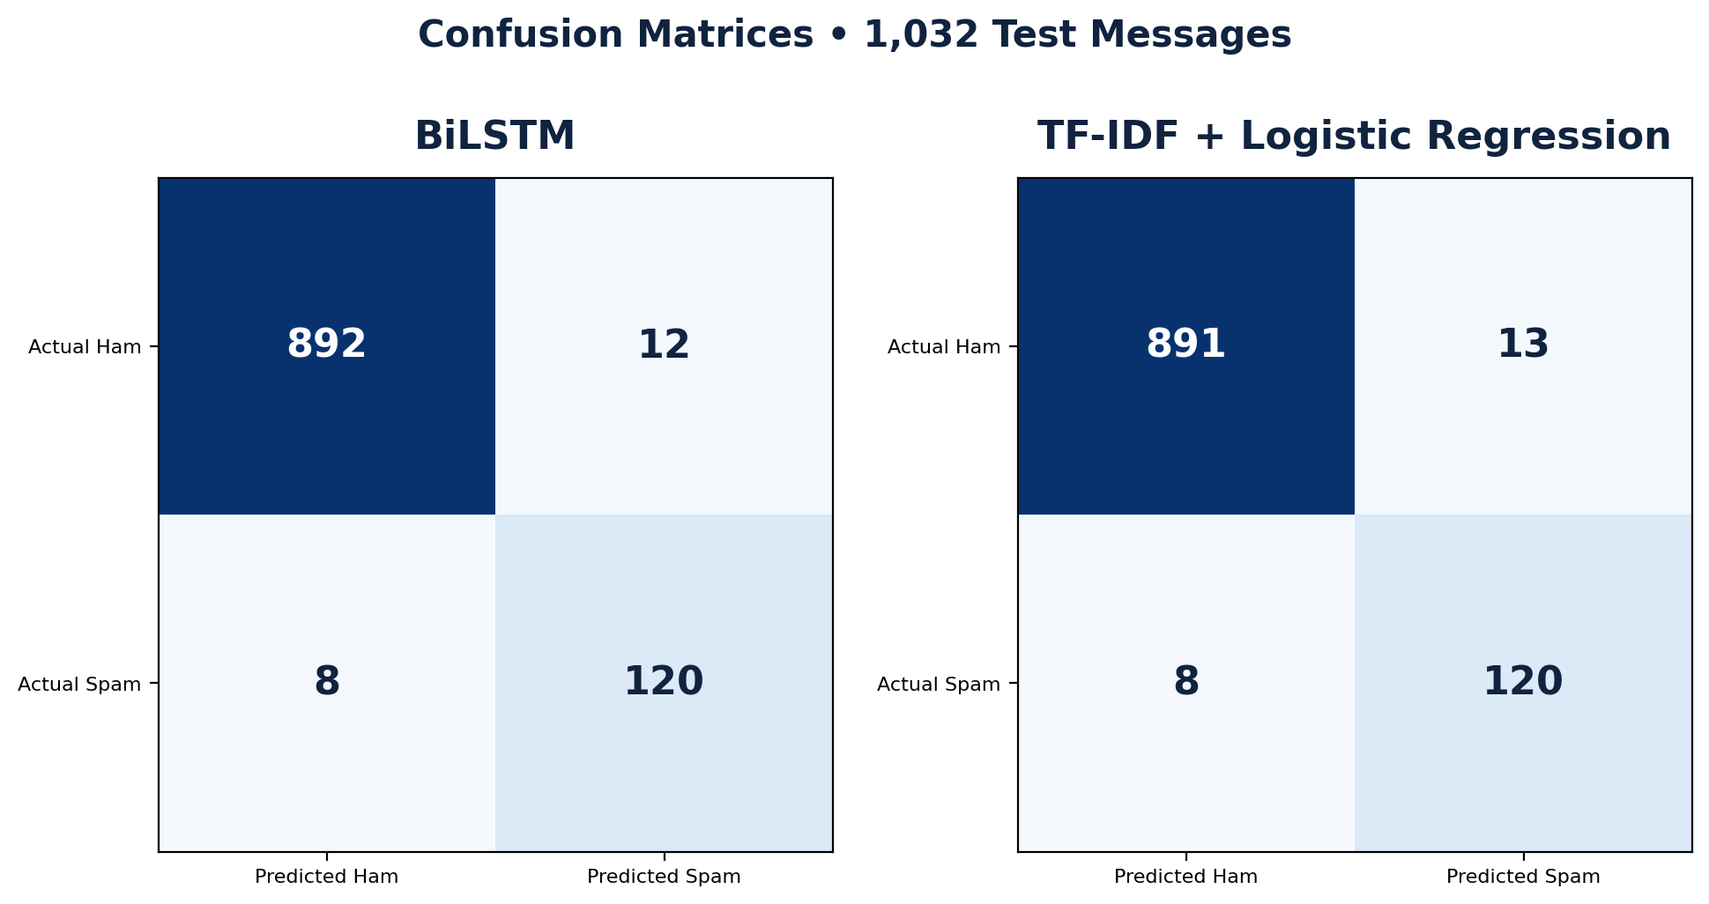
EXPERIMENTAL RESULTS
BiLSTM Achieves 98.06% Accuracy and Superior 92.31% F1-Score
Benchmark Scorecard
Accuracy: BiLSTM 98.06% vs Baseline 97.97% (+0.09% gain).
Spam Precision: BiLSTM 90.91% vs Baseline 90.23% (1 fewer false alarm).
Spam Recall: Identical 93.75% (both catch 120 / 128 spam messages).
Spam F1-Score: BiLSTM 92.31% vs Baseline 91.95% (+0.36% advantage).
BiLSTM (Left: 892 TN, 12 FP) vs TF-IDF Baseline (Right: 891 TN, 13 FP) on 1,032 Test Samples
SMS Spam Detection | Parallel Code & Theory Walkthrough | Slide 10 of 13

Slide 11
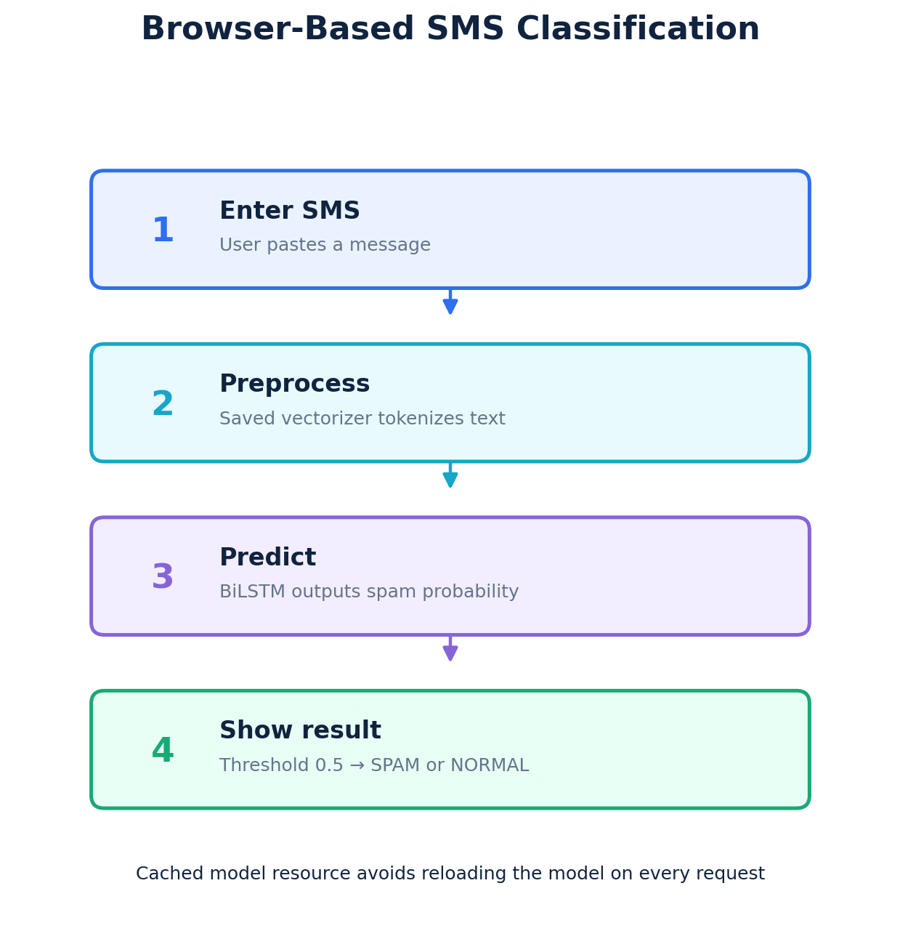
STAGE 6: WEB APPLICATION
Cached Artifact Loading Enables Instant Browser Classification
Inference Architecture & Code
@st.cache_resource: Loads serialized model once into memory, preventing reload lag.
End-to-End Pipeline: model.predict(tf.constant([msg])) executes vectorizer and neural graph.
Sigmoid Discretization: score >= 0.5 boundary classifies message as SPAM or NORMAL.
Sub-15ms Latency: Pure CPU tensor execution yields instantaneous user feedback.
SMS Spam Detection | Parallel Code & Theory Walkthrough | Slide 11 of 13

Slide 12
VIVA VOCE READINESS
Key Technical Viva Questions and Architectural Defense
Why BiLSTM vs RNN?
Vanishing Gradients: Standard RNN gates collapse over sequences >15 tokens.
Bidirectional Context: Future tokens resolve early ambiguous words like 'free' or 'account'.
Parameter Economy: 32 recurrent units achieve high accuracy without overparameterization.
Data Leakage Risks
Vocabulary Fitting: Vectorizer adapted ONLY on X_train to preserve holdout blindness.
Duplicate Handling: 403 duplicate rows identified in EDA must not cross partition lines.
Corpus Stratification: Stratified splitting ensures representative test evaluation.
Production Reality
Marginal DL Advantage: BiLSTM yields 92.31% F1 vs 91.95% linear ML (modest gain).
Latency vs Compute: Logistic Regression is 10x faster; DL captures nuanced syntax.
Concept Drift: Modern spam evolves adversarial obfuscations requiring retraining.
SMS Spam Detection | Parallel Code & Theory Walkthrough | Slide 12 of 13

Slide 13
Thank You.

